Slide 1
Global Energy Consumption Analysis
CIVE7100
By: Srivathsav Mitnala

Slide 2
Recap
Non-renewable energy resources are depleting at a rapid rate
China is the country which is consuming the most energy from coal, oil and gas
Countries have started to focus on looking for alternative sources of energy since prior to 2010s

Slide 3
Agenda for the final presentation
Renewable energy production rate
Correlation analysis
Observe trends in oil energy consumption
Analysing coal reserves across the globe
Model application
Metrics Evaluation

Slide 4
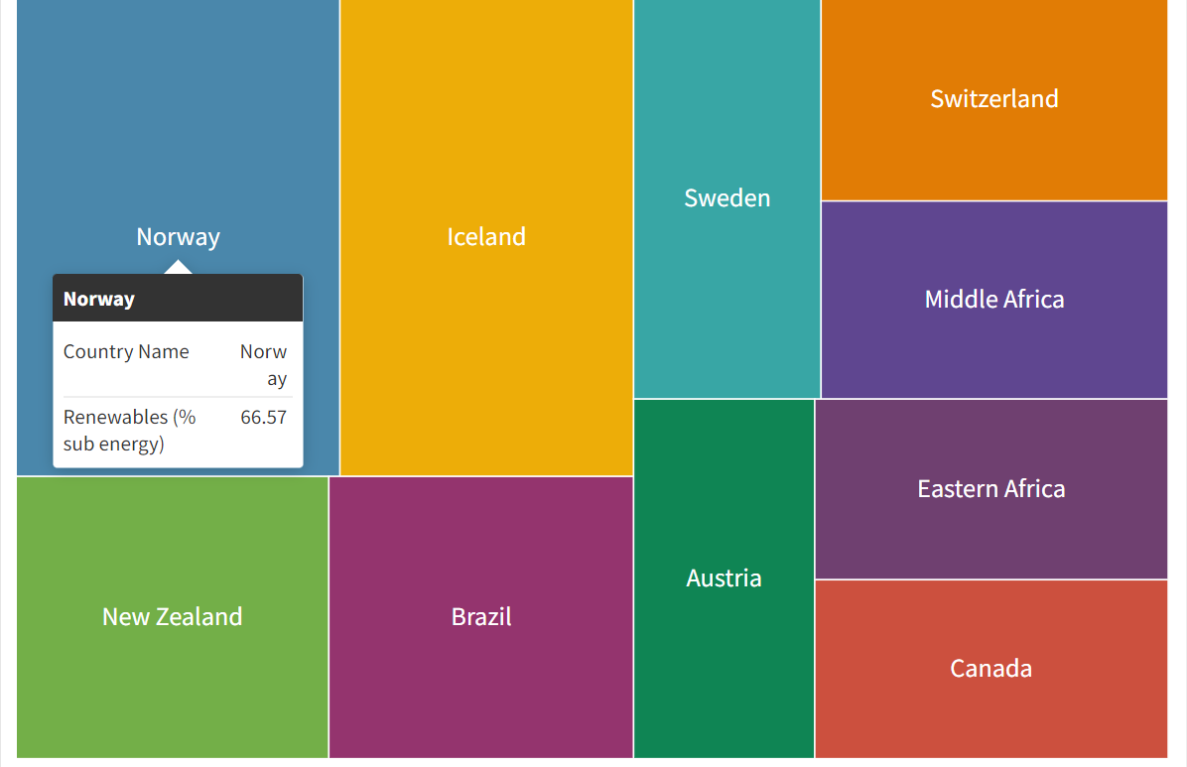
Renewable energy production rate

Slide 5
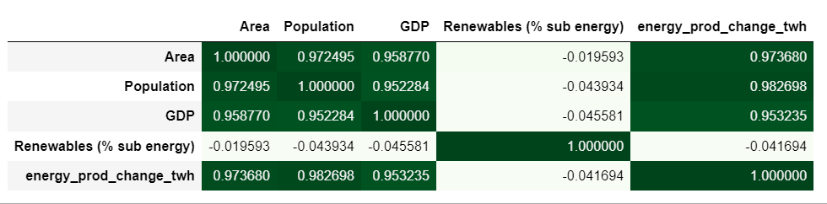
Energy production correlation analysis

Slide 6
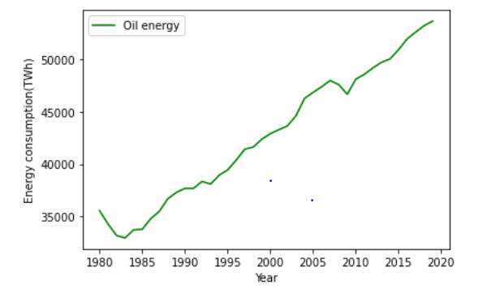
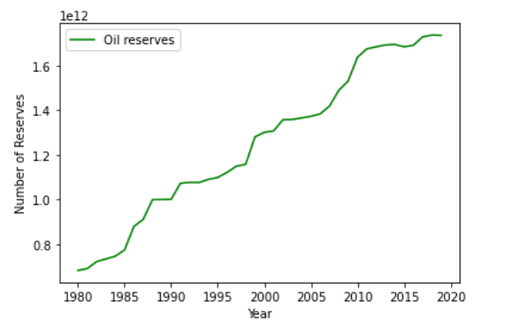
Oil Energy Consumption
The number of oil reserves have started to slowly decline, but the rate of energy consumption from these reserves has not changed and there has been an increasing trend.

Slide 7
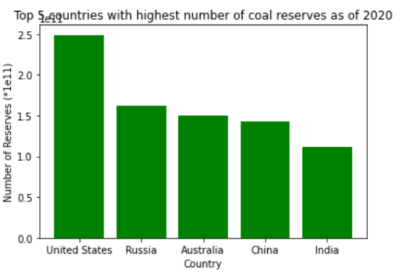
Coal Reserves
China consumed 82.7 BTu of coal energy in 2020, and is highest among all the other countries by a fair margin.
Whereas USA consumed 9.2 Btu of energy from coal

Slide 8
Models Applied
Linear Regression
ARIMA Model
LSTM

Slide 9
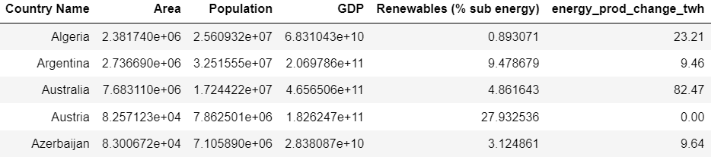
This is the sample of data on which Linear Regression was applied, the features used were based on the correlation analysis from earlier in the presentation.

Slide 10
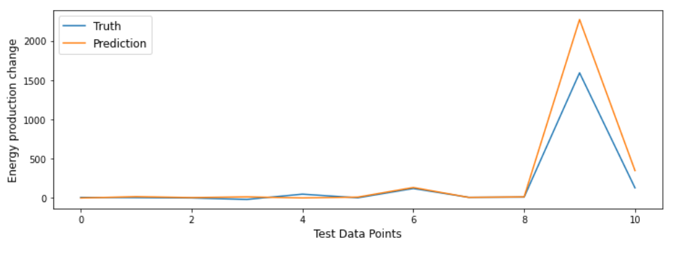

Linear Regression
The results from the linear regression were pretty decent, as the R2 value is close to 1, it can further be improved by adding more features.

Slide 11
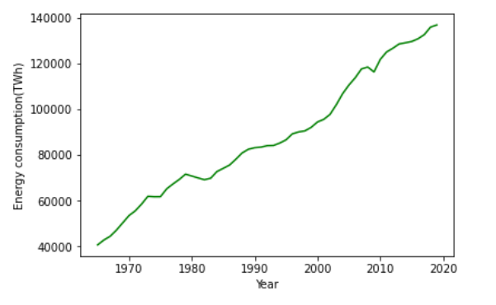
The Arima and the LSTM models were applied on this data which had the overall energy consumption from fossil fuels globally per year between 1965-2019

Slide 12
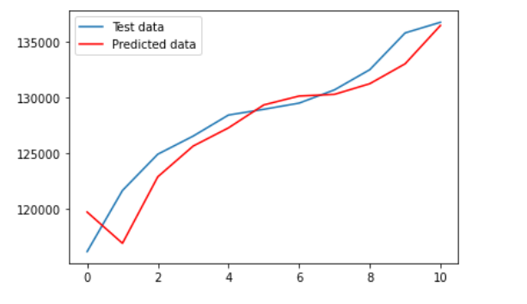

ARIMA Model
The results from the ARIMA model was very good , as can be seen from the R2 value which is almost 0.9

Slide 13
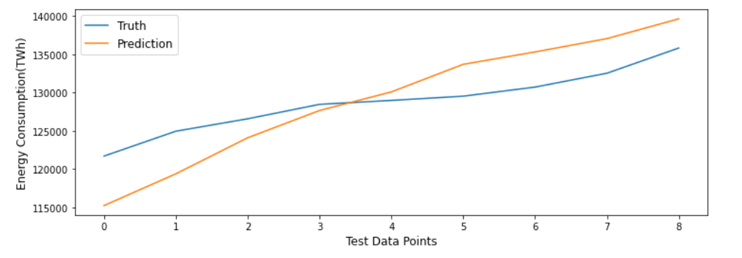

LSTM
The results from LSTM were not that great, because of low training data count leading to lower number of epochs performed for LSTM.

Slide 14
Conclusions and further research
China has consumed the most energy from fossil fuels over the last 50 years owing to its high population and requirements for the industries they prominently contribute to.
The number of oil and coal reserves have slowly been declining across countries but the energy consumption from these sources has seen a steady increase.
Further research for this project would be to identify more features to get even better results in case of linear regression model.
Identifying a particular industry and finding features that would contribute to energy consumption from fossil fuels by that industry would be the next step in this project.

Slide 15
Sources
https://ourworldindata.org/grapher/coal-proved-reserves?tab=chart
https://machinelearningmastery.com/how-to-develop-lstm-models-for-time-series-forecasting/
https://machinelearningmastery.com/arima-for-time-series-forecasting-with-python/
https://www.bp.com/en/global/corporate/energy-economics/statistical-review-of-world-energy.html
https://ourworldindata.org/energy
https://data.worldbank.org/

Slide 16
THANK YOU!!

